Slide 1

SKI RESORT PROPERTIES CASE STUDY
Rubina Shaik, Anurag Lahon, Anamika Singh

Slide 2
CONTENTS
OBJECTIVE
ANALYTICAL OVERVIEW
EXPLORATORY DATA ANALYSIS
MODEL BUILDING
MODEL SELECTION
REGRESSION ASSUMPTIONS
VALIDATION OF MODEL
CONCLUSIONS

Slide 3

OBJECTIVE
AGENDA is to build a model to predict the selling price of the new houses coming onto the market

Slide 4
ANALYTICAL OVERVIEW
1. Analysis of Data
Types of Data- All the variables are numeric. No categorical data
Missing Data- No missing data in the data set.
Analysis- EDA and Multiple Linear Regression followed by Model Validation
2. Package used :
ggplot, tidyverse,Funmodelling,Hmisc,DataExplorer, corrplot packages to perform EDA
Mass, olsrr,leaps,car,boot packages for MLR
3. Visualization:
Histogram, Bar graphs,Density plot, Scatterplot, pairplot, heatmap.

Slide 5
EXPLORATORY DATA ANALYSIS
Dataset Summary : 39 Observations and 11 variables
Correlation Matrix
Relation between Selling Price and the other variables

Slide 6
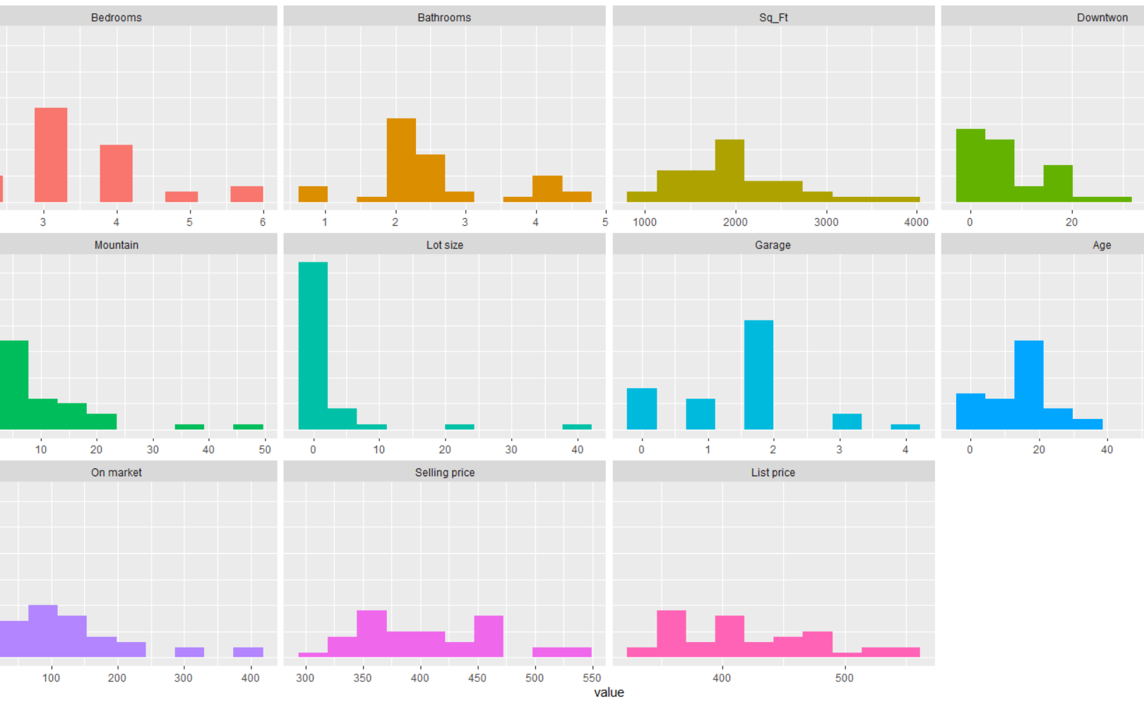
HistograM

Slide 7
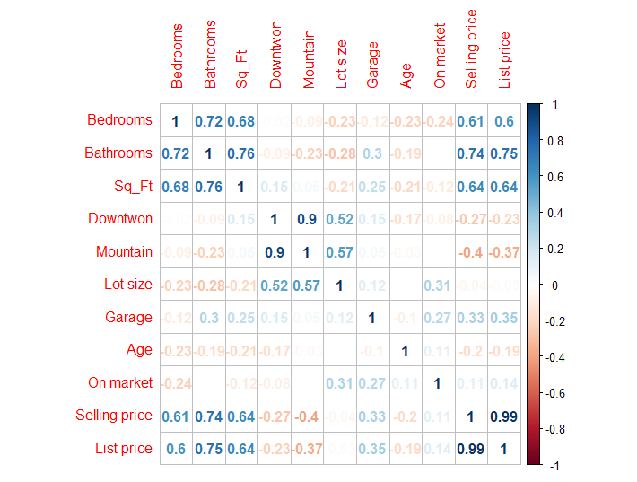
Correlation MATRIX

Slide 8
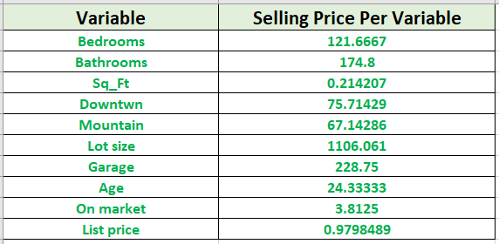
Selling Price v/s VARIABLES

Slide 9

MODEL BUILDING
Decide predictor variables
Used 3 different functions : stepAIC, ols_step_best_subset, regsubsets.
Two possible models built

Slide 10
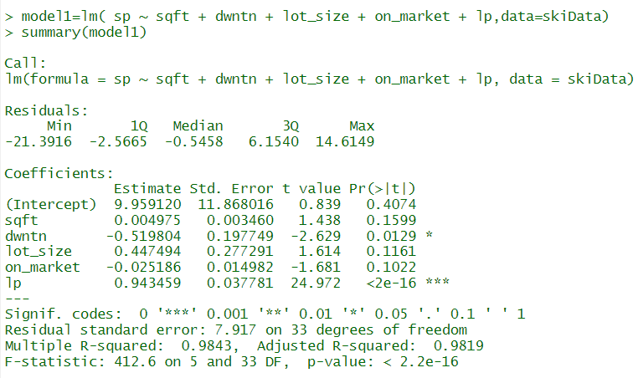
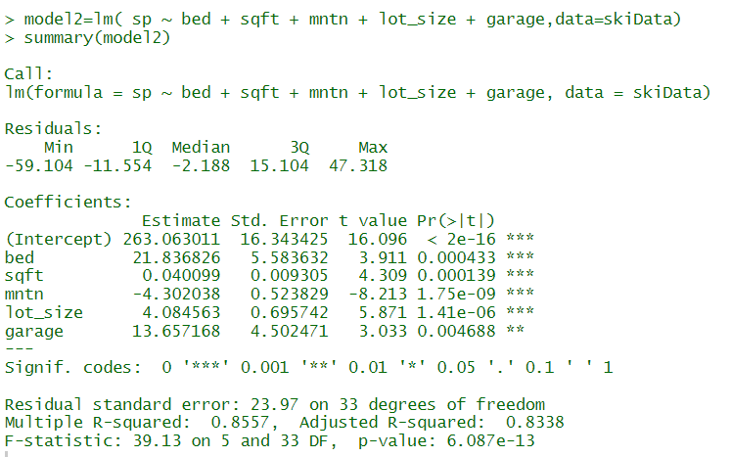
Model 1: MODEL 2:

Slide 11
MODEL SELECTION
Best Model is selected considering
R2 and adjusted R2
Significant p values
Cp index
AIC and BIC
Vif

Slide 12
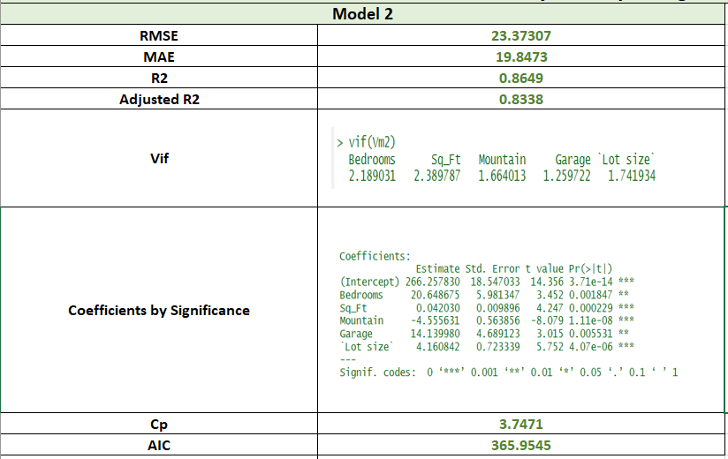
Deciding values of MODEL

Slide 13


FINAL EQUATION of model
SELLING PRICE= 266.26 + 20.65(BEDROOMS) + 0.042(SQ_FT) – 4.55(MOUNTAIN) + 14.14(GARAGE) + 4.16(LOT SIZE)
where
Selling price in $1000
Bedrooms- Number of bedrooms
Sqft- area of house in square feet
Mountain- miles from the property to the base of the ski resort’s facing mountain
Garage- Number of cars that will fit into the garage
Lot Size - size of the property in acres

Slide 14

REGRESSION ASSUMPTIONS
Normality
Equal variance
Collinearity
Independence of errors

Slide 15
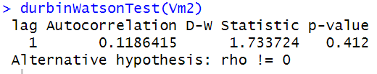
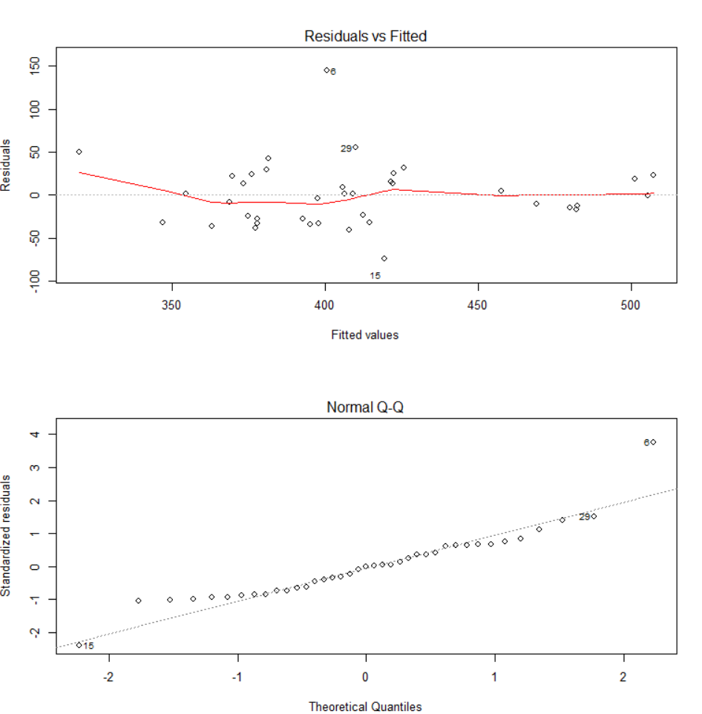
Durbin Watson Test:
There is no auto correlations present between the errors
Residual Diagnostic Plots

Slide 16
VALIDATION OF MODEL
Type 1: Data Splitting
Split the data into testing and training data set.
33 rows as training rows to build the regression model
6 rows as testing rows to make predictions.
RMSE, MAE,P-values are calculated and compared.
Type 2 : K fold Cross Validation
As the data is limited , we can perform a K Fold Cross Validation to eliminate overfitting

Slide 17
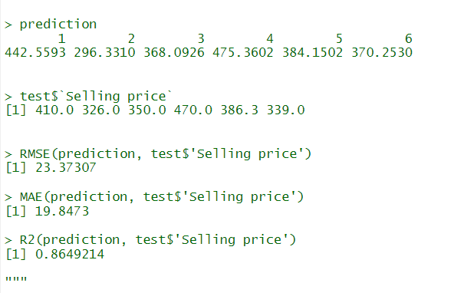
Predicted and Test Values from Data Splitting Validation

Slide 18
conclusions
List Price is the proxy to Selling Price , so including list price as a predictor variable decreases the significance of the other variables included.
The best model to predict the selling price of the homes in Colorado Ski Resort is SELLING PRICE= 266.26 + 20.65(BEDROOMS) + 0.042(SQ_FT) – 4.55(MOUNTAIN) + 14.14(GARAGE) + 4.16(LOT SIZE)
The age or the time the house is on market do not effect the selling price.
With the increasing miles of mountain base , the selling price decreases. So lower the miles of mountain better the selling price.

Slide 19

THANK YOU

